Slide 1


micro:bit entry video tutorial
Lesson 8
micro:bit basic lesson 8 “Good morning, good night”
YahBoom micro:bit video tutorial

Slide 2
micro:bit entry video tutorial
Content
Part1
Part 2
Part3
Part 4
Part 5
Learning goals
Preparation
Search for blocks
Combine blocks
Have a try
YahBoom micro:bit video tutorial

Slide 3
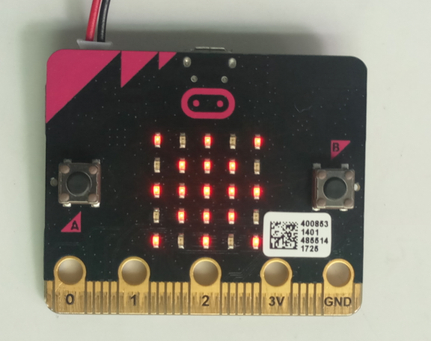
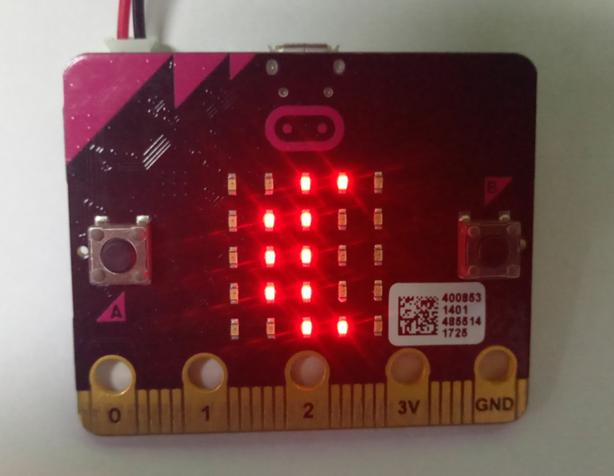
micro:bit entry video tutorial
Part 1
Learning goals
Sunlight
(Good morning)
Moon
(Good evening)
After downloading the program,When the micro:bit development board is in the brighter environment, a pattern of the sun will be displayed on the dot matrix, which means to say "good morning" to everyone. similarly, when in a dark environment, the moon pattern will be displayed on the dot matrix, which means to say "good night" to everyone.
YahBoom micro:bit video tutorial

Slide 4
micro:bit entry video tutorial
Part 2
Hardware:
● 1 X Micro: bit Board
● 1 X Micro USB Cable
● 2 X AAA batteries
Preparation
Then the micro:bit is connected to the computer through USB, and the computer will pop up a U disk and click the URL in the U disk to enter the programming interface.
YahBoom micro:bit video tutorial

Slide 5
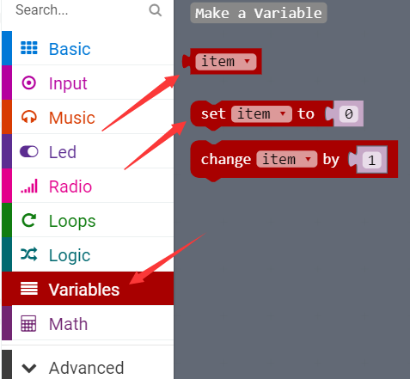
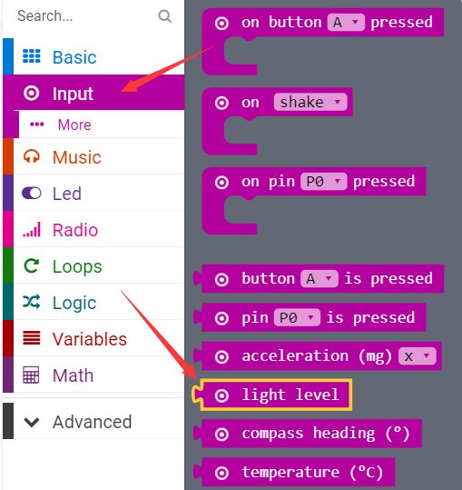
micro:bit entry video tutorial
Part 3
Search for blocks
YahBoom micro:bit video tutorial

Slide 6
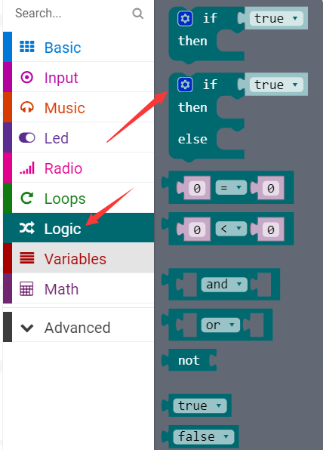
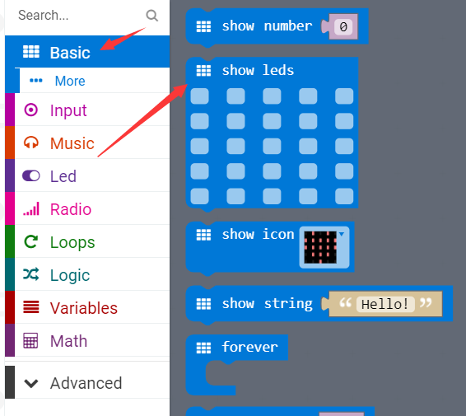
micro:bit entry video tutorial
Part 3
Search for blocks
YahBoom micro:bit video tutorial

Slide 7
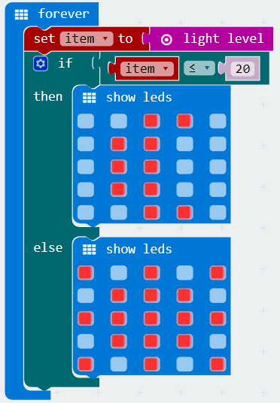
micro:bit entry video tutorial
Part 4
20 here is an intermediate value set freely,The meaning of building blocks is that:If the current light intensity is less than 20, the moon will appear on the dot matrix. If greater than 20, the
sun will appear.
Median value: Put all the numbers in numerical order. If there is an odd number of results, the median is the middle number. If there is an even number of results, the median will be the mean of the two central numbers.
(in this course, you can set the middle value on your own).
Combine blocks
YahBoom micro:bit video tutorial

Slide 8


micro:bit entry video tutorial
Part 5
Do you learn the course today?
If you learn to do it, give yourself a top quack.
Now give you a homework assignment.
The value of the current luminance is displayed on the micro:bit dot matrix.
Children can use the mobile phone lights or turn off the lights at home to change the current brightness.
Start your little brain. Try it.
Have a try
YahBoom micro:bit video tutorial

Slide 9
micro:bit entry video tutorial
micro:bit
project
Thanks for watching！
Powered by YahBoom
YahBoom Micro:bit video tutorial

